Slide 1
Chapter 4
Consumer Behavior, Market Research, and Advertisement

Slide 2
Learning Objectives
Describe the factors that influence consumer behavior online.
Understand the decision-making process of consumer purchasing online.
Describe how companies are building one-to-one relationships with customers.
Explain how personalization is accomplished online.
Discuss the issues of e-loyalty and e-trust in EC.
Describe consumer market research in EC.

Slide 3
Learning Objectives
Describe Internet marketing in B2B, including organizational buyer behavior.
Describe the objectives of Web advertising and its characteristics.
Describe the major advertising methods used on the Web.
Describe various online advertising strategies and types of promotions.
Describe permission marketing, ad management, localization, and other advertising-related issues.
Understand the role of intelligent agents in consumer issues and advertising applications.

Slide 4
Learning about
Consumer Behavior Online
A Model of Consumer Behavior Online
  Independent (or uncontrollable) variables can be categorized as personal characteristics and environmental characteristics
  Intervening (or moderating) variables are variables within the vendors’ control. They are divided into market stimuli and EC systems
  The decision-making process is influenced by the independent and intervening variables. This process ends with the buyers’ decisions resulting from the decision-making process
  The dependent variables describe types of decisions made by buyers

Slide 5
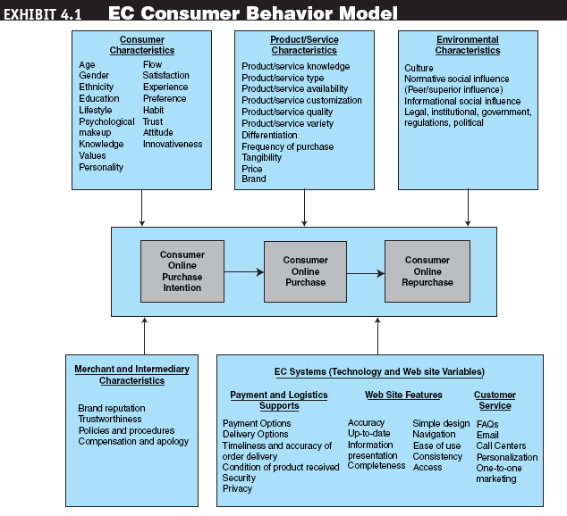
Learning about
Consumer Behavior Online

Slide 6
Learning about
Consumer Behavior Online
  The independent variables
    Personal characteristics
    Environmental variables
    Social variables
    Cultural/community variables
    Other environmental variables
  The intervening (moderating) variables
  The dependent variables: the buying decisions

Slide 7
The Consumer
Decision-Making Process
Roles people play in the decision-making process
  Initiator
  Influencer
  Decider
  Buyer
  User
A Generic Purchasing-Decision Model
  Need identification
  Information search
  Evaluation of alternatives,
  Purchase and delivery
  Post-purchase behavior

Slide 8
The Consumer
Decision-Making Process
A Customer Decision Model in Web Purchasing
  Can be supported by both Consumer Decision Support System (CDSS) facilities and Internet and Web facilities

Slide 9
Mass Marketing, Market Segmentation, and One-to-One Marketing
one-to-one marketing
Marketing that treats each customer in a unique way
Mass Marketing
  Marketing efforts traditionally were targeted to everyone
  Targeted marketing—marketing and advertising efforts targeted to groups (market segmentation) or to individuals (one-to-one)—is a better approach

Slide 10
Mass Marketing, Market Segmentation, and One-to-One Marketing
market segmentation
The process of dividing a consumer market into logical groups for conducting marketing research and analyzing personal information

Slide 11
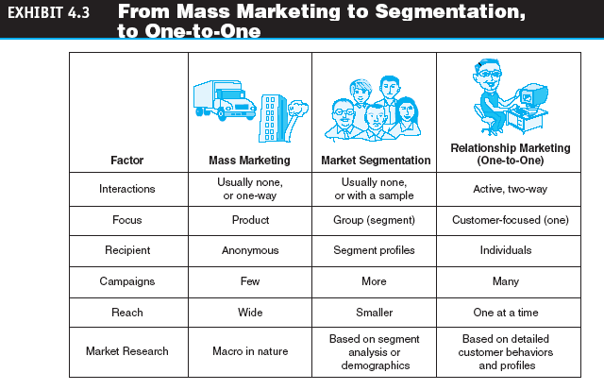
Mass Marketing, Market Segmentation, and One-to-One Marketing

Slide 12
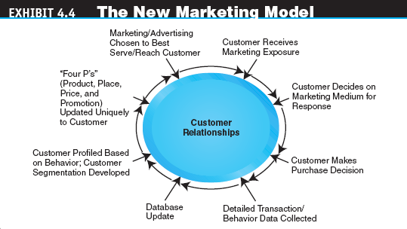
Mass Marketing, Market Segmentation, and One-to-One Marketing

Slide 13
Personalization, Loyalty,
Trust, and Satisfaction in EC
personalization
The matching of services, products, and advertising content with individual consumers and their preferences
The major strategies used to compile user profiles include the following:
  Solicit information directly from the user
  Observe what people are doing online
  Build from previous purchase patterns
  Make inferences

Slide 14
Personalization, Loyalty,
Trust, and Satisfaction in EC
user profile
The requirements, preferences, behaviors, and demographic traits of a particular customer
cookie
A data file that is placed on a user’s hard drive by a remote Web server, frequently without disclosure or the user’s consent, that collects information about the user’s activities at a site

Slide 15
Personalization, Loyalty,
Trust, and Satisfaction in EC
Customer Loyalty
  e-loyalty
  Customer loyalty to an e-tailer or loyalty programs delivered online or supported electronically

Slide 16
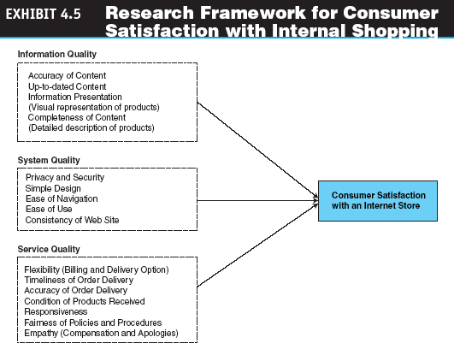
Personalization, Loyalty,
Trust, and Satisfaction in EC

Slide 17
Personalization, Loyalty,
Trust, and Satisfaction in EC
trust
The psychological status of willingness to depend on another person or organization
  How to increase trust in EC
    Affiliate with an objective third party
    Establish trustworthiness

Slide 18
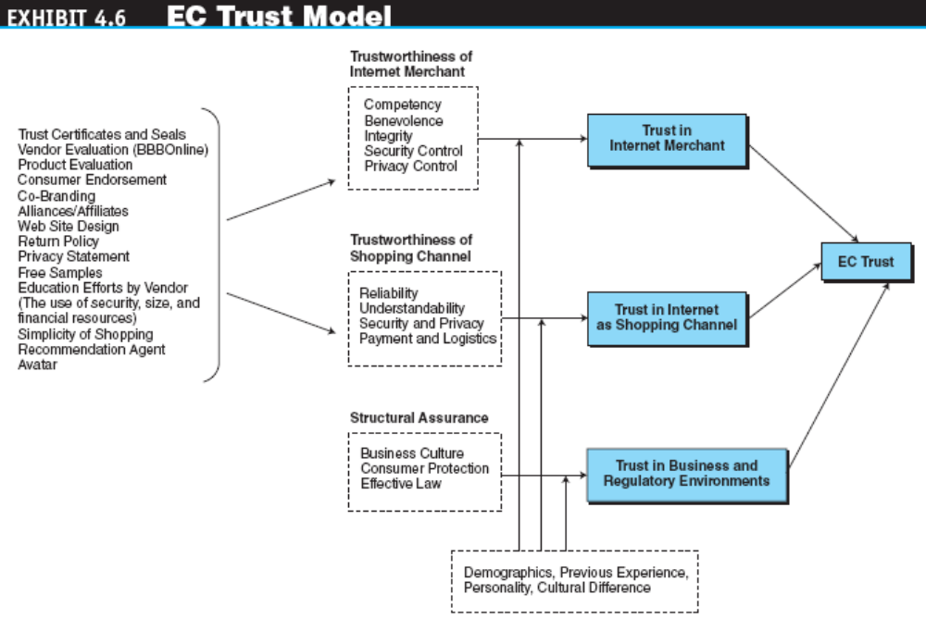
Personalization, Loyalty,
Trust, and Satisfaction in EC

Slide 19
Market Research for EC
Methods for Conducting Market Research Online
  Market research that uses the Internet frequently is faster and more efficient and allows the researcher to access a more geographically diverse audience
  Web market researchers can conduct a very large study much more cheaply than with other methods

Slide 20
Market Research for EC
  What are marketers looking for in EC market research?
    What are the purchase patterns for individuals and groups (market segmentation)?
    What factors encourage online purchasing?
    How can we identify those who are real buyers from those who are just browsing?
    How does an individual navigate—does the consumer check information first or do they go directly to ordering?
    What is the optimal Web page design?

Slide 21
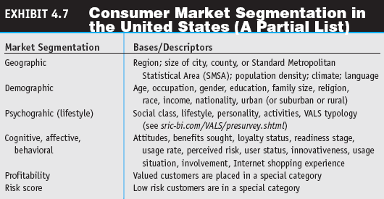
Market Research for EC

Slide 22
Market Research for EC
Market research for one-to-one approaches
  Direct solicitation of information (surveys, focus groups)
  Observing what customers are doing on the Web
  Collaborative filtering

Slide 23
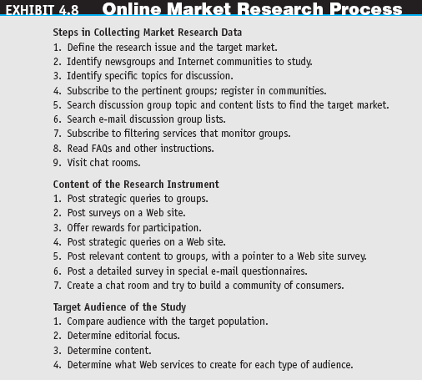
Market Research for EC

Slide 24
Market Research for EC
  Observing Customers
    transaction log
    A record of user activities at a company’s Web site
    clickstream behavior
    Customer movements on the Internet
    Web bugs
    Tiny graphics files embedded in e-mail messages and in Web sites that transmit information about users and their movements to a Web server
    spyware
    Software that gathers user information over an Internet connection without the user’s knowledge

Slide 25
Market Research for EC
  clickstream data
  Data that occur inside the Web environment; they provide a trail of the user’s activities (the user’s clickstream behavior) in the Web site
  clickstream data
  Data that occur inside the Web environment; they provide a trail of the user’s activities (the user’s clickstream behavior) in the Web site

Slide 26
Market Research for EC
  collaborative filtering
  A market research and personalization method that uses customer data to predict, based on formulas derived from behavioral sciences, what other products or services a customer may enjoy; predictions can be extended to other customers with similar profiles

Slide 27
Market Research for EC
  Variations of collaborative filtering include:
    Rule-based filtering
    Content-based filter
    Content-based filter
  Legal and ethical issues in collaborative filtering

Slide 28
Market Research for EC
Limitations of Online Market Research and How to Overcome Them
  To use data properly, one needs to organize, edit, condense, and summarize it, which is expensive and time consuming
  The solution to this problem is to automate the process by using data warehousing and data mining known as business intelligence

Slide 29
Market Research for EC
Biometric Marketing
  biometrics
  An individual’s unique physical or behavioral characteristics that can be used to identify an individual precisely (e.g., fingerprints)
Organizational Buyer Behavior
  A Behavioral Model of Organizational Buyers
    An organizational influences module is added to the B2B model

Slide 30
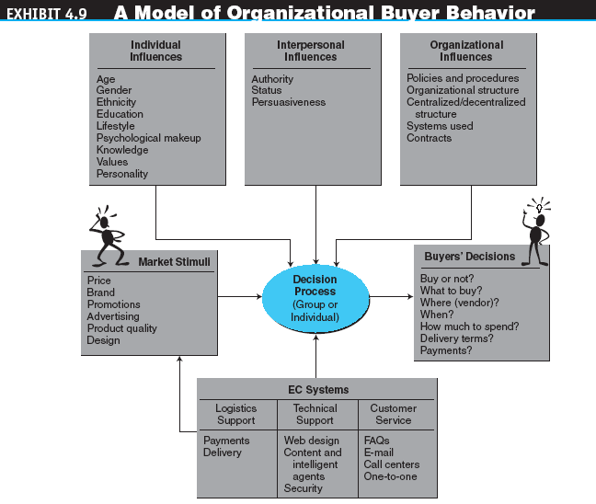
Internet Marketing in B2B

Slide 31
Internet Marketing in B2B
Methods for B2B Online Marketing
  Targeting customers
  Electronic wholesalers
  Other B2B marketing services
    Digital cement
    National systems
    Businesstown
  Affiliate Programs
  Infomediaries
  Online Data Mining Services

Slide 32
Web Advertising
interactive marketing
Online marketing, facilitated by the Internet, by which marketers and advertisers can interact directly with customers and consumers can interact with advertisers/vendors

Slide 33
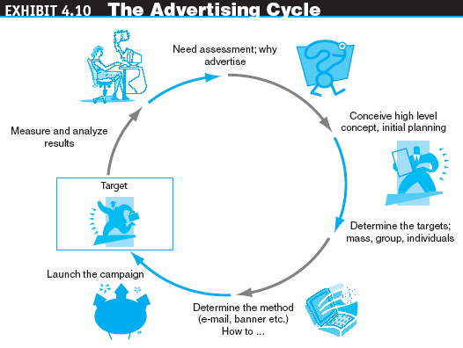
Web Advertising

Slide 34
Web Advertising
Some Internet Advertising Terminology
  ad views
  The number of times users call up a page that has a banner on it during a specific period; known as impressions or page views
  click (click-through or ad click)
  A count made each time a visitor clicks on an advertising banner to access the advertiser’s Web site
  CPM (cost per thousand impressions)
  The fee an advertiser pays for each 1,000 times a page with a banner ad is shown

Slide 35
Web Advertising
  conversion rate
  The percentage of clickers who actually make a purchase
  click-through rate (or ratio)
  The percentage of visitors who are exposed to a banner ad and click on it
  click-through ratio
  The ratio between the number of clicks on a banner ad and the number of times it is seen by viewers; measures the success of a banner in attracting visitors to click on the ad

Slide 36
Web Advertising
  hit
  A request for data from a Web page or file
  visit
  A series of requests during one navigation of a Web site; a pause of a certain length of time ends a visit
  unique visits
  A count of the number of visitors entering a site, regardless of how many pages are viewed per visit
  stickiness
  Characteristic that influences the average length of time a visitor stays in a site

Slide 37
Web Advertising
Why Internet Advertising?
Precise targeting
Interactivity
Rich media (grabs attention)
Cost reduction
Customer acquisition
Personalization
Timeliness
Location-basis
Linking
Digital branding

Slide 38
Web Advertising
advertising networks
Specialized firms that offer customized Web advertising, such as brokering ads and targeting ads to select groups of consumers

Slide 39
Online Advertising Methods
banner
On a Web page, a graphic advertising display linked to the advertiser’s Web page
keyword banners
Banner ads that appear when a predetermined word is queried from a search engine
random banners
Banner ads that appear at random, not as the result of the user’s action

Slide 40
Online Advertising Methods
banner swapping
An agreement between two companies to each display the other’s banner ad on its Web site
banner exchanges
Markets in which companies can trade or exchange placement of banner ads on each other’s Web sites

Slide 41
Online Advertising Methods
pop-up ad
An ad that appears in a separate window before, after, or during Internet surfing or when reading e-mail
pop-under ad
An ad that appears underneath the current browser window, so when the user closes the active window the ad is still on the screen
interstitial
An initial Web page or a portion of it that is used to capture the user’s attention for a short time while other content is loading

Slide 42
Online Advertising Methods
E-Mail Advertising
  E-mail advertising management
  E-mail advertising methods and successes
Newspaper-Like and Classified Ads
Search Engine Advertisement
  Improving a company’s search-engine ranking (optimization)
  Paid search-engine inclusion

Slide 43
Online Advertising Methods
  associated ad display (text links)
  An advertising strategy that displays a banner ad related to a key term entered in a search engine
  Google—The online advertising king
Advertising in Chat Rooms, Blogs, and Social Networks

Slide 44
Online Advertising Methods
Other Forms of Advertising
  advertorial
  An advertisement “disguised” to look like editorial content or general information
  Advertising in newsletters
  Posting press releases online
  advergaming
  The practice of using computer games to advertise a product, an organization, or a viewpoint

Slide 45
Advertising Strategies and Promotions Online
affiliate marketing
A marketing arrangement by which an organization refers consumers to the selling company’s Web site
With the ads-as-a-commodity approach, people are paid for time spent viewing an ad
viral marketing
Word-of-mouth marketing by which customers promote a product or service by telling others about it

Slide 46
Advertising Strategies and Promotions Online
  Webcasting
  A free Internet news service that broadcasts personalized news and information, including seminars, in categories selected by the user
Online Events, Promotions, and Attractions
  Live Web Events
  Admediation
    admediaries
    Third-party vendors that conduct promotions, especially large-scale ones
  Selling space by pixels

Slide 47
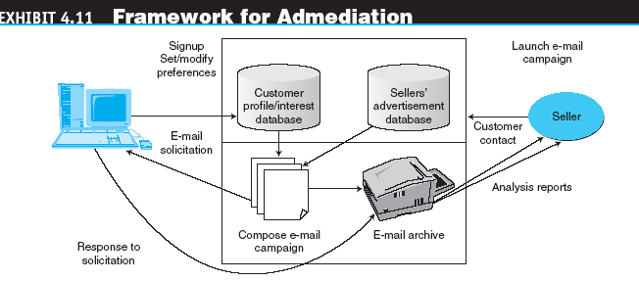
Advertising Strategies and Promotions Online

Slide 48
Special Advertising Topics
PERMISSION ADVERTISING
  spamming
  Using e-mail to send unwanted ads (sometimes floods of ads)
  permission advertising (permission marketing)
  Advertising (marketing) strategy in which customers agree to accept advertising and marketing materials (known as “opt-in”)

Slide 49
Special Advertising Topics
Advertisement as a Revenue Model
Measuring Online Advertising’s Effectiveness
ad management
Methodology and software that enable organizations to perform a variety of activities involved in Web advertising (e.g., tracking viewers, rotating ads)

Slide 50
Special Advertising Topics
localization
The process of converting media products developed in one environment (e.g., country) to a form culturally and linguistically acceptable in countries outside the original target market
Internet radio
A Web site that provides music, talk, and other entertainment, both live and stored, from a variety of radio stations

Slide 51
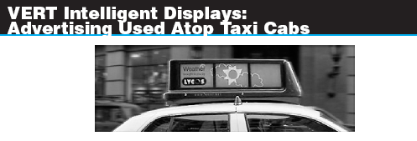
Special Advertising Topics
Wireless Advertising
Ad Content

Slide 52
Software Agents in
Marketing and Advertising Applications
A Framework for Classifying EC Agents
  Agents that support need identification (what to buy)
  Agents that support product brokering (from whom to buy)
  Agents that support merchant brokering and comparisons
  Agents that support buyer–seller negotiation
  Agents that support purchase and delivery
  Agents that support after-sale service and evaluation

Slide 53
Software Agents in
Marketing and Advertising Applications
Character-Based Animated Interactive Agents
  avatars
  Animated computer characters that exhibit humanlike movements and behaviors
  social computing
  An approach aimed at making the human–computer interface more natural
  chatterbots
  Animation characters that can talk (chat)

Slide 54
Managerial Issues
Do we understand our customers?
Should we use intelligent agents?
Who will conduct the market research?
Are customers satisfied with our Web site?
Can we use B2C marketing methods and research in B2B?
How do we decide where to advertise?

Slide 55
Managerial Issues
What is our commitment to Web advertising, and how will we coordinate Web and traditional advertising?
Should we integrate our Internet and non-Internet marketing campaigns?
What ethical issues should we consider?
Are any metrics available to guide advertisers?
Which Internet marketing/advertising channel to use?

